Slide 1
ARCHITECTURE FOR BIG DATA SYSTEMS
Le Thi Minh Chau
Faculty Of Information Technology
HCMC University Of Technology And Education

Slide 2
Module Contents
Big Data Components
Big Data Use Cases Comparison
Big Data Architectures

Slide 3
Module Contents
Big Data Components
Big Data Use Cases Comparison
Big Data Architectures

Slide 4
Big Data Components
Data Source
Data Collection, Processing and Loading (CPL)
Data Analysis and Aggregation
Interface and Visualization
Job and Model Specification

Slide 5
Data Source
Source
Relational data
Streaming data
Structured, unstructured, semi-structured data

Slide 6
Data Collection, Processing and Loading
Data Collection
Snapshot
Data Processing
Data Cleaning
Replication
Filtering
Algorithm Service
Data Loading
Into a data storage such as Hadoop HDFS

Slide 7
Data Analysis and Aggregation
Data Analysis
Pig, Hive, Impala…
Data Aggregation
Data storage (including multidimentional): stores the results of the analysis.

Slide 8
Interface and Visualization
End users as well as applications such as dashboards.

Slide 9
Job and Model Specification
Models trained, specifications and scheduling of jobs.

Slide 10
Module Contents
Big Data Components
Big Data Use Cases Comparison
Big Data Architectures

Slide 11
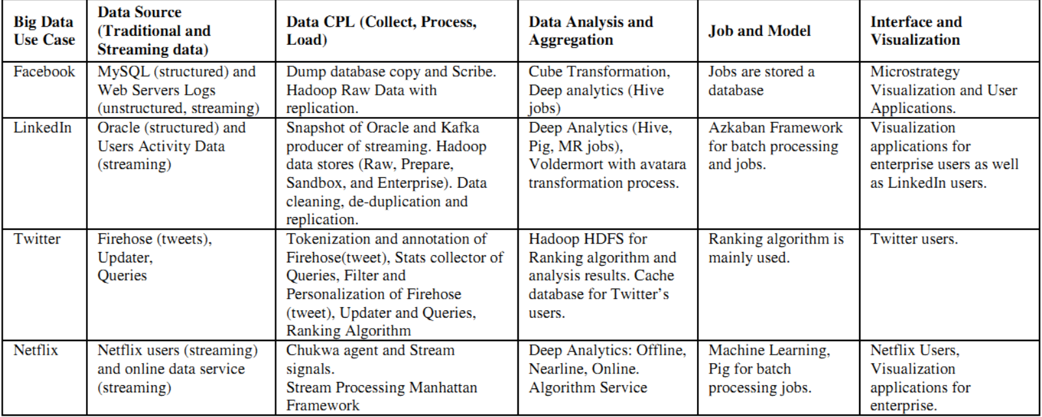
Big Data Use Cases Comparison

Slide 12
Module Contents
Big Data Components
Big Data Use Cases Comparison
Big Data Architectures

Slide 13
Big Data Architecture
Reference Architecture Notations
Some Use Case Architecture

Slide 14
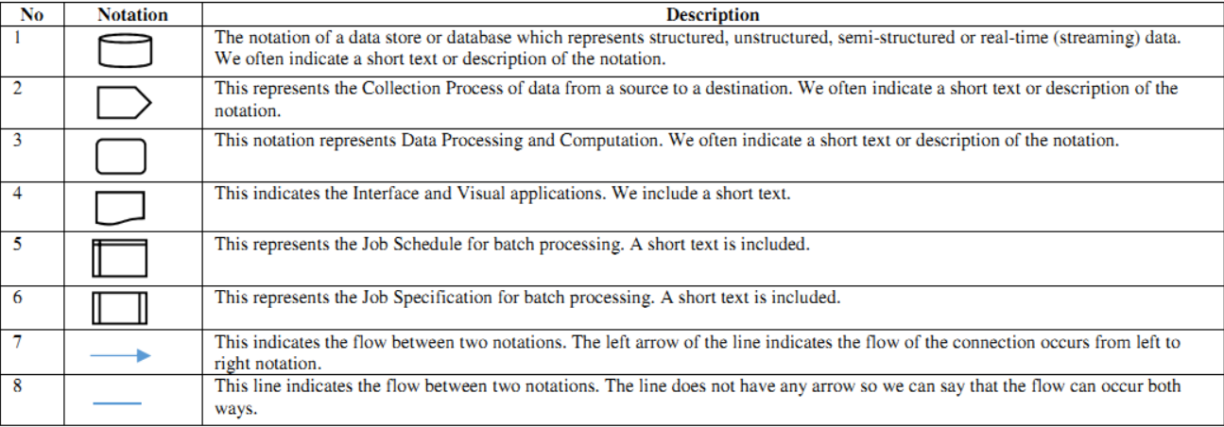
Reference Architecture Notations

Slide 15
Some Use Case Architecture
Facebook
Amazon
Other

Slide 16
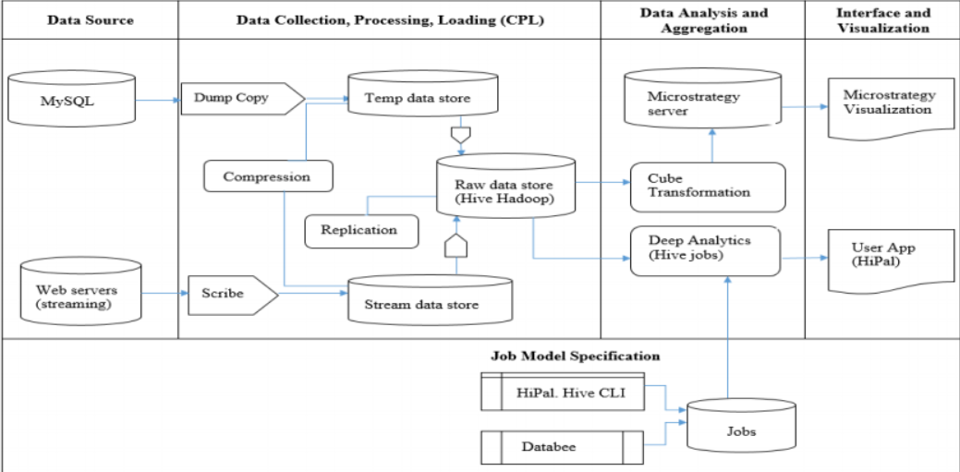
Mapping Facebook Use Case Reference Architecture

Slide 17
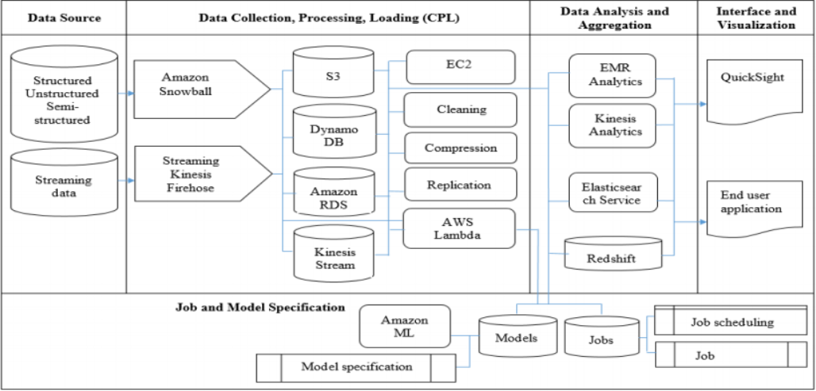
Amazon Analytics Services Reference Architecture

Slide 18
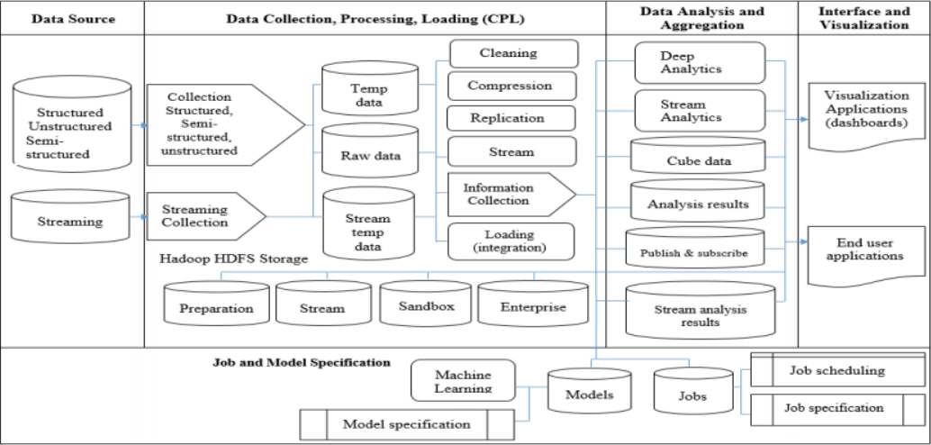
Big Data Use Case Reference Architecture

Slide 19

Q&A

